Slide 1
Komnas HAM:
PSN and Merauke Food Estate
Saurlin Siagian, Commissioner, NHRI Indonesia 2022 - 2027

Slide 2
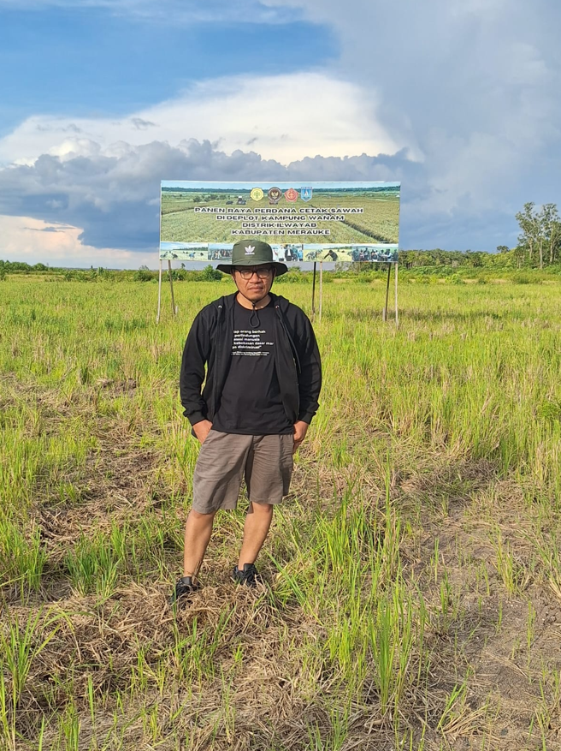
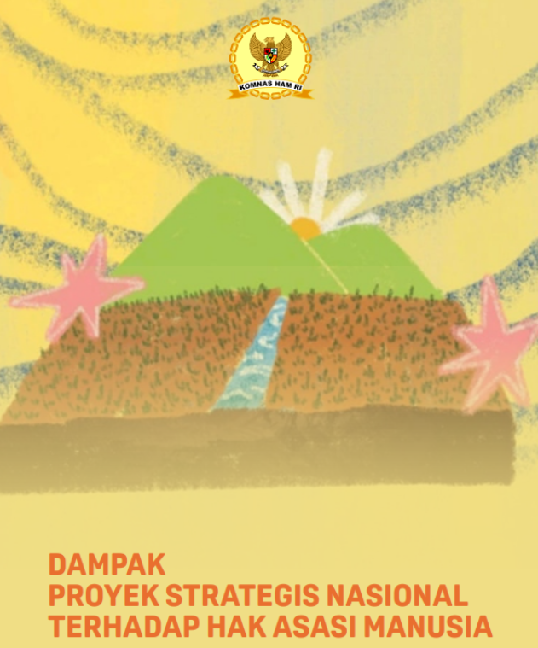
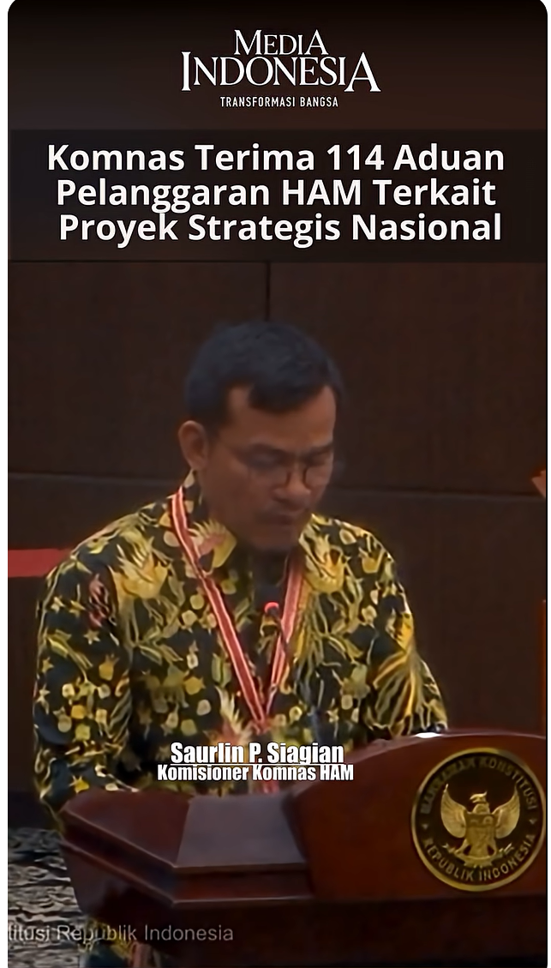
3 Points:
Komnas Ham findings: PSN Impacts on Human Rights (2024)
PSN-Merauke: Investigation and findings (2025)
Komnas HAM on PSN in the Constitutional Court (2025)

Slide 3
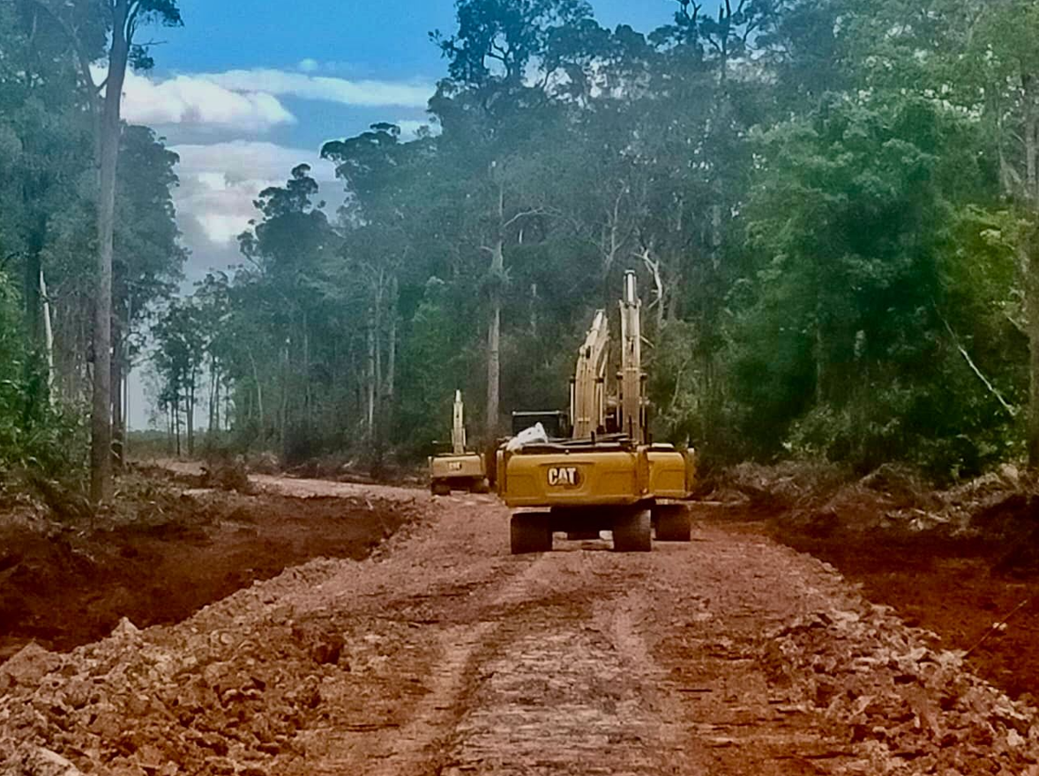
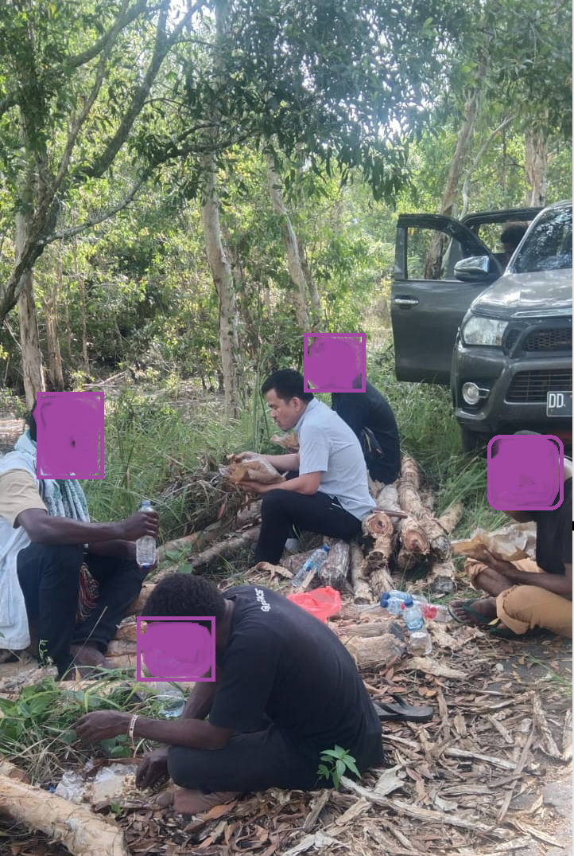
Merauke…

Slide 4
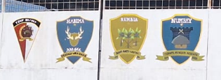
Non Organic Forces/troops

Slide 5
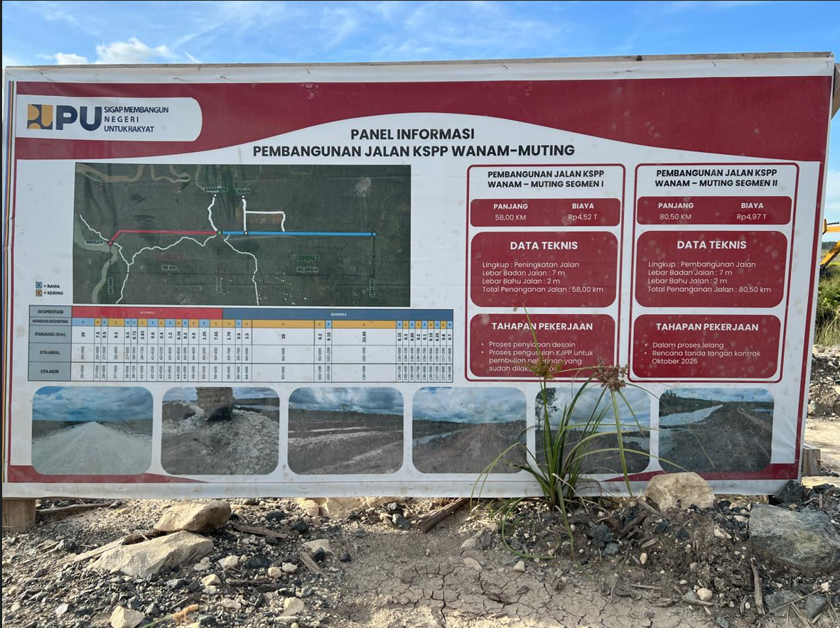
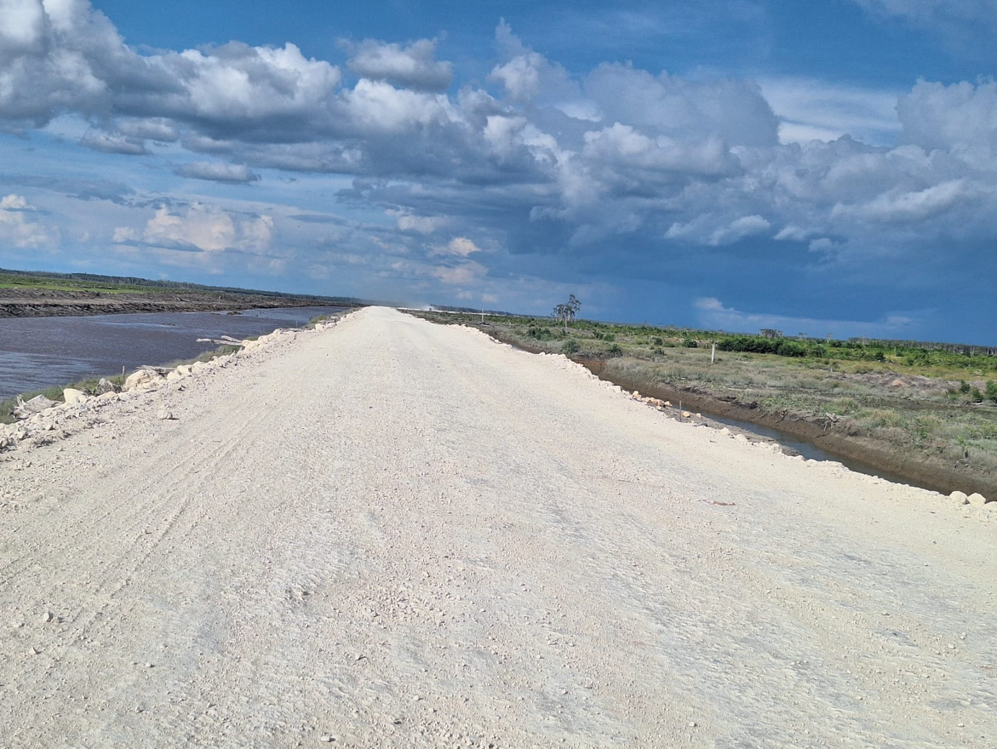
Wanam..

Slide 6
Investigation findings
Agrarian conflicts have occurred in several villages affected by the PSN. These conflicts are related to sugarcane plantation projects for bioethanol, land concessions, as well as rice field expansion (“food estate”) projects and supporting infrastructure development. In a number of locations, there have been findings of control over and clearing of customary (ulayat) land without a mechanism of Free, Prior and Informed Consent (FPIC), including the installation of boundary markers, land clearing, and infrastructure development on customary territories that remain under dispute.
Komnas HAM also notes that, to date, there has been no formal recognition by the Regional Government of the existence of Indigenous law communities in these areas, despite the fact that these communities have strong historical, cultural, and spiritual ties to the land, forests, rivers, and wetlands that constitute their living space. For Indigenous peoples, these territories are not merely economic resources, but an integral part of their cultural identity and way of life.
Furthermore, Komnas HAM found limitations in participation and transparency. Indigenous communities stated that they were not meaningfully involved from the planning stage and did not receive adequate access to licensing documents, concession maps, or environmental impact assessments. Large-scale land clearing has resulted in the loss of gardens, sago forests, hunting grounds, water sources, and other traditional food sources, thereby increasing the social, economic, and cultural vulnerability of the communities.
Komnas HAM also observed the involvement of armed security personnel in the context of agrarian conflicts, which has generated concern among community members. The presence of security forces in land dispute situations has the potential to create unequal power relations and to restrict the freedom of communities to express opinions or objections freely. In several locations, there have also been reports of community leaders being reported to law enforcement authorities, as well as the potential for horizontal conflict among residents.
Moreover, Komnas HAM identified a lack of clarity in governance and coordination between the central government and regional governments in the implementation of PSN, including discrepancies in information regarding project locations and program modalities in the field. This situation indicates issues of transparency and accountability in project implementation.

Slide 7
Komnas HAM at the Constitutional Court- Conclusion:
The PSN provisions in the Job Creation Law contain vague norms that are inconsistent with the principles of the rule of law and legal certainty.
The implementation of PSN has resulted in actual violations of constitutional rights: the right to a healthy environment, the right to security, and property rights.
The top-down governance model of PSN has produced projects that are not human rights–friendly and tends to eliminate meaningful public participation.
There is a clear gap between the normative objectives of PSN and the realities on the ground, often resulting in social conflict and the criminalization of citizens.
PSN has caused serious environmental damage, while existing environmental instruments have not functioned effectively.
The excessive involvement of security apparatuses in the implementation of PSN threatens the full respect, protection, and fulfillment of human rights.
The loss of Indigenous peoples’ access to land and culture due to PSN threatens their cultural identity and the sustainability of their rights.

Slide 8
Recommendation on the UU Cipta Kerja on PSN
Komnas HAM submits the following recommendations to the Constitutional Court for consideration in its judgment:
The Constitutional Court should reaffirm that every norm within the Job Creation Law, particularly those concerning PSN, must comply with the rule of law as stipulated in Article 1(3) of the 1945 Constitution of the Republic of Indonesia, as well as with the obligation to respect, protect, and fulfill human rights as guaranteed under Articles 28A to 28J of the 1945 Constitution. Vague norms that open opportunities for abuse of authority should be declared unconstitutional and subject to revocation or review.
To re-examine the development model embodied in PSN, as it is highly exclusive, generates discrimination, enables abuse of power, and leads to recurring human rights violations.
The Constitutional Court is expected to adopt a constitutional interpretation that is not merely textual and rigid, but responsive to contemporary developments and oriented toward the protection of human rights. Such interpretation aims to position the Constitution as a “living constitution” that remains relevant to societal needs, emphasizing justice, public benefit, and respect for fundamental rights. In this regard, the Court is expected to affirm protection of the right to participate in development, rights to land and natural resources, Indigenous peoples’ rights, the right to a good and healthy environment, and the right to food. This approach is consistent with the 1945 Constitution and with national and international human rights instruments ratified by Indonesia.
With respect to norms that expand the concept of “public interest” to include corporate interests, the Court should reassess their compatibility with Article 33(3) of the 1945 Constitution. It must be emphasized that economic development cannot serve as justification for the dispossession of land and living space without adequate protection mechanisms.
The Constitutional Court should affirm that the implementation of PSN cannot disregard principles of oversight and checks and balances, including the supervisory role of the House of Representatives (DPR) in development policies, such as forest conversion and alignment with spatial planning (RTR/RZ). Norms that eliminate such controls should be declared inconsistent with the 1945 Constitution.
The Constitutional Court is expected to issue a ruling that is not only corrective but also preventive, by instructing the legislature to amend PSN regulations to ensure compliance with constitutional principles, human rights standards, and environmental sustainability.

Slide 9

Komnas HAM Study on PSN (2024)
Eksklusif
Top down
Penyalagunaan wewenang (potensi/pemicu)
Minim akuntabilitas
Intimidasi
Kekerasan
Kriminalisasi
Alat negosiasi
Menurunnya kesejahteraan
Krisis pangan
Tata kelola PSN
Pengadaan lahan
Pencemaran
Polusi
Deforestasi
Meningkatkan emisi karbon
Perubahan iklim
Kesimpulan
Intimidasi
Kekerasan
Kriminalisasi
Kekuatan berlebih
Penyalahgunaan wewenang
Diskriminatif
Kerusakan LH & SDA
Aparat keamanan dan APH
Minimnya akses keadilan
Pelanggaran HAM berulang
Korupsi
Tidak adanya mekanisme pengaduan dan pemulihan

